Slide 1

Team Alpha
Software Engineering - Fall 2024

Slide 2
Our Original Vision Statement
“Our goal as a team is to develop an engaging guitar hero style rhythm game where players compete to achieve the highest possible scores by accurately hitting keys in sync with the notes displayed on the screen. The game will feature multiple difficulty levels, each designed to challenge players' timing and reflexes as the speed and complexity of the gameplay increase.
To enhance the player experience, we will incorporate a scoring system and a leaderboard to display user scores for specific songs. These features will allow players to track their progress and strive for personal improvement, whether on their uploaded songs or those already built into the game. Additionally, we plan to implement a database to store user scores, enabling players to monitor their growth over time and aim for increasingly higher scores with each playthrough.
To support an expansive and customizable gameplay experience, we will develop a file upload system integrated with a backend framework. This system will allow users to easily add new songs to the game. When uploading a file, players can select a difficulty setting, ensuring the game accommodates a wide range of skill levels and preferences.
Through these features, we aim to deliver a compelling prototype of a rhythm game as part of our software engineering project. Our team is confident that this combination of dynamic gameplay, customization options, and competitive elements will provide a highly enjoyable and memorable experience for players. “

Slide 3
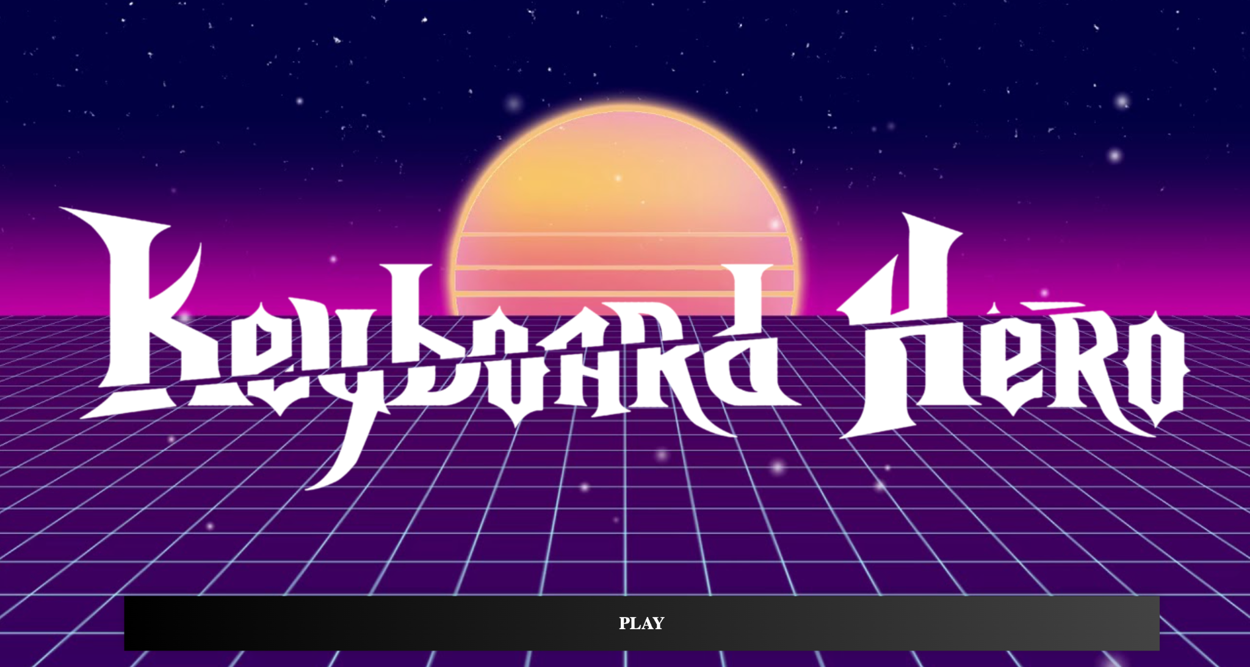
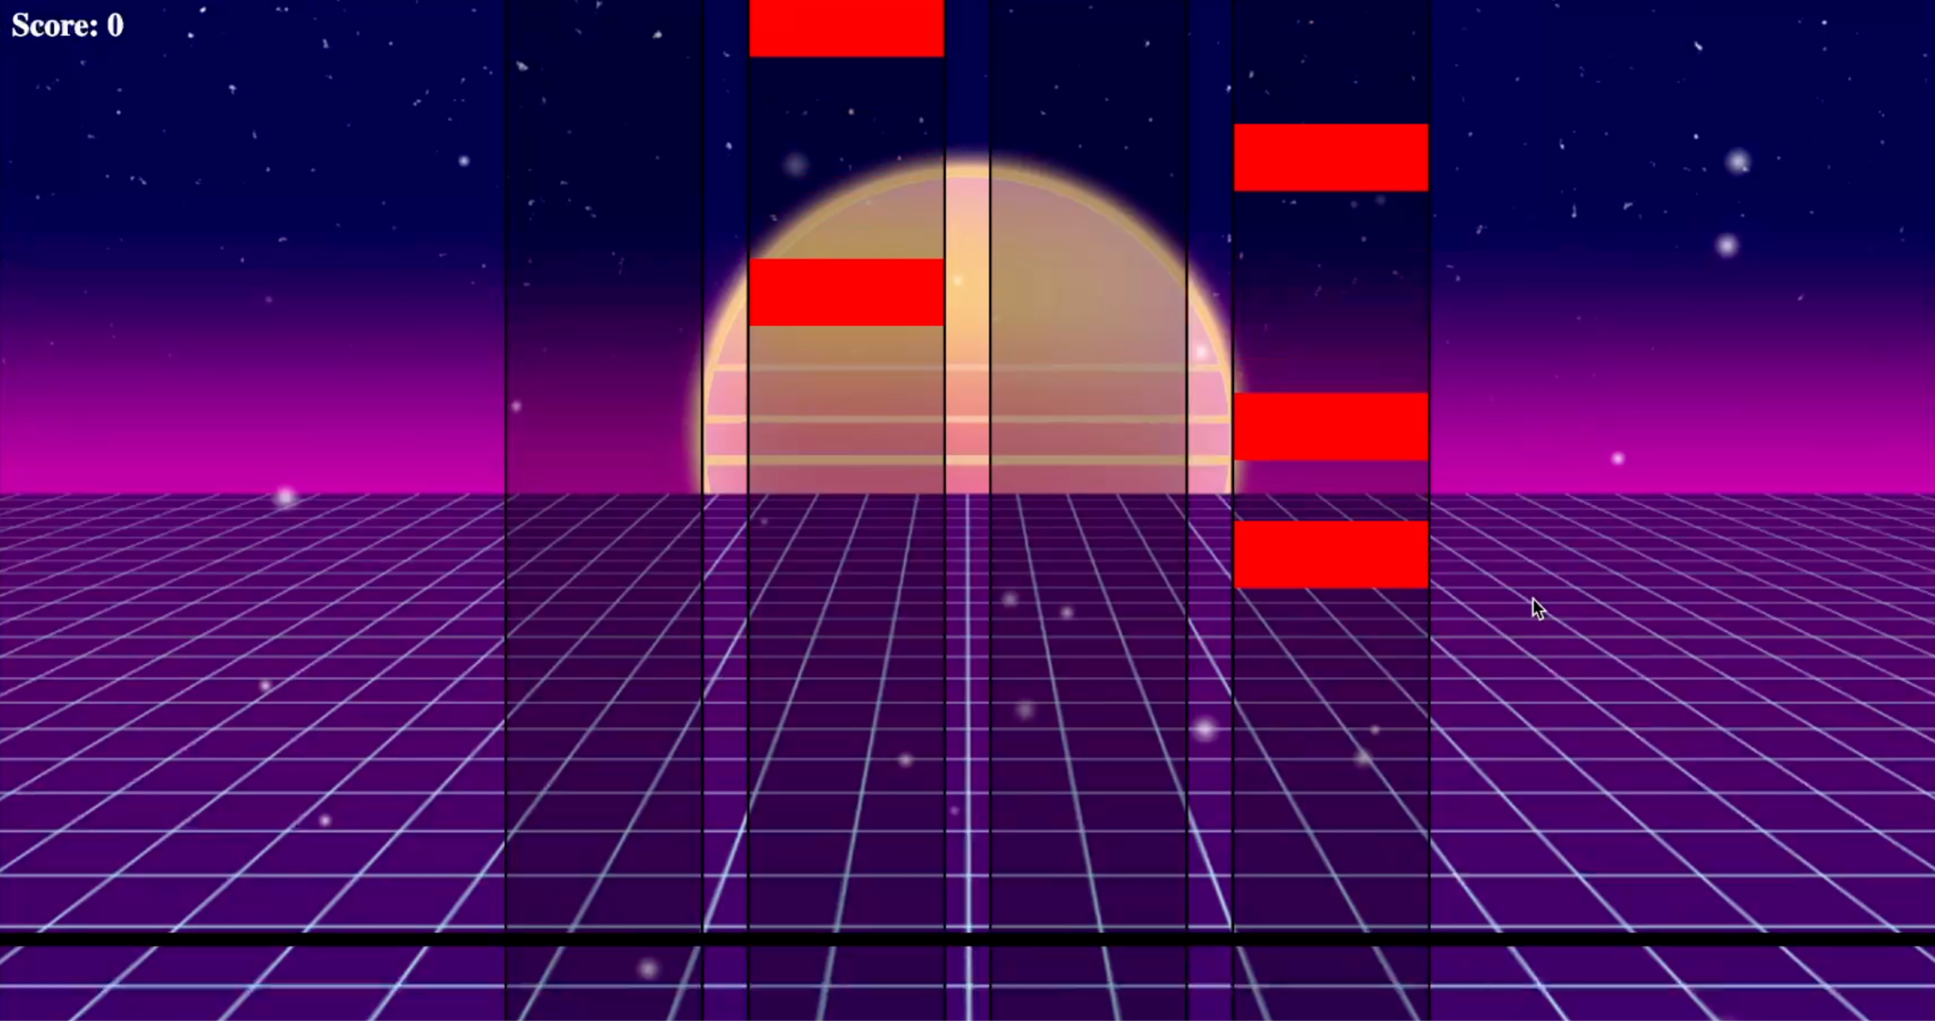
Design Process
Started off basic.
No music
Simple page changes
Gravity affected tiles

Slide 4
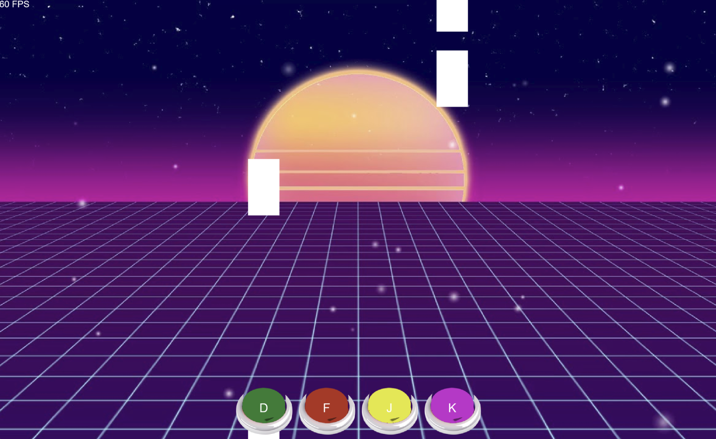
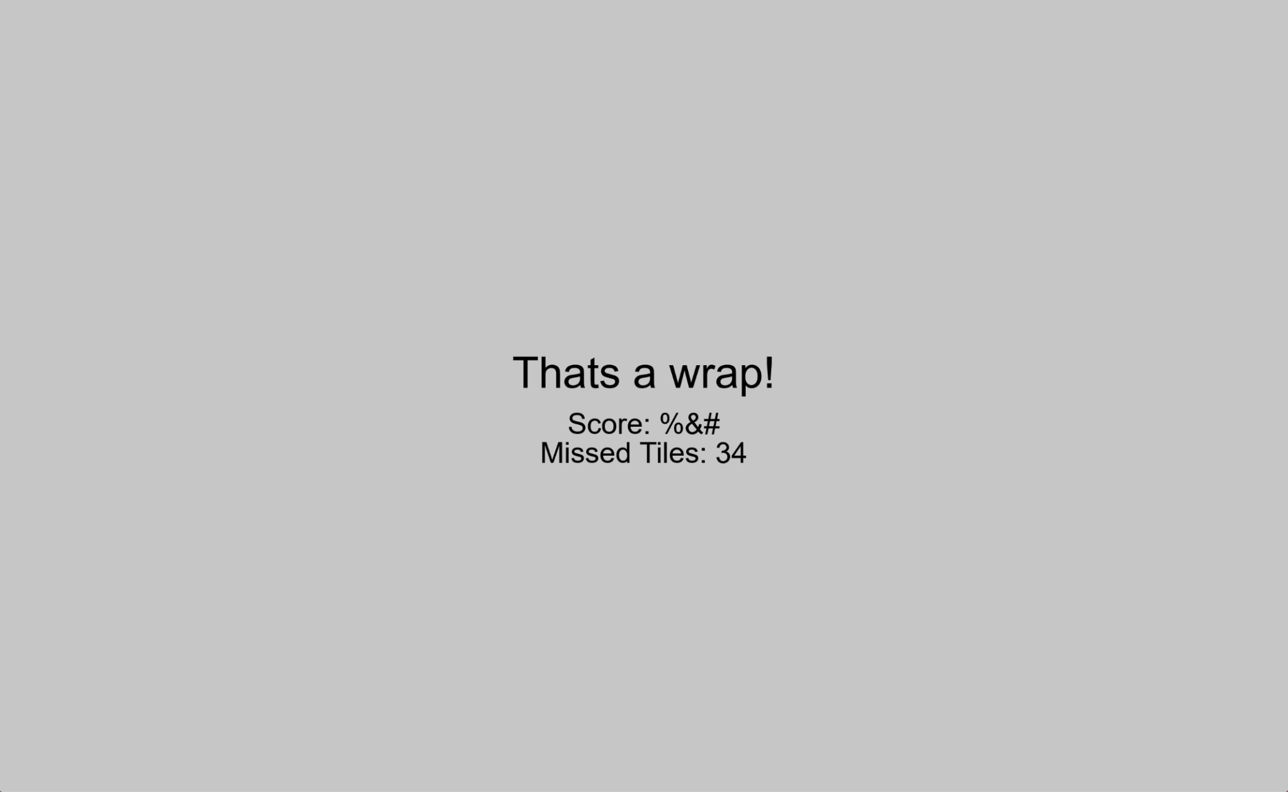
A menu manager that loaded pages without refreshing the page
Music that follows the game
Tiles that moved in sync with audio
The first iteration of the game complete screen
Basic
Showed missed notes
No score

Slide 5
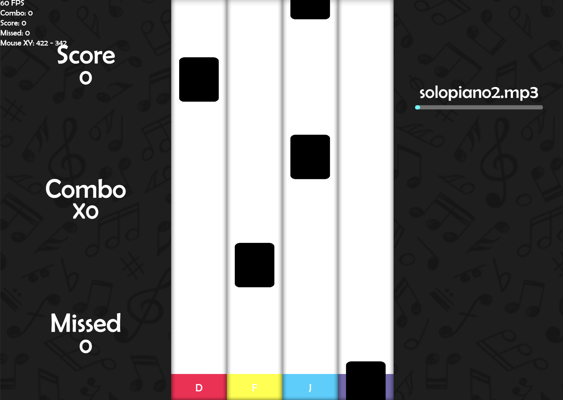
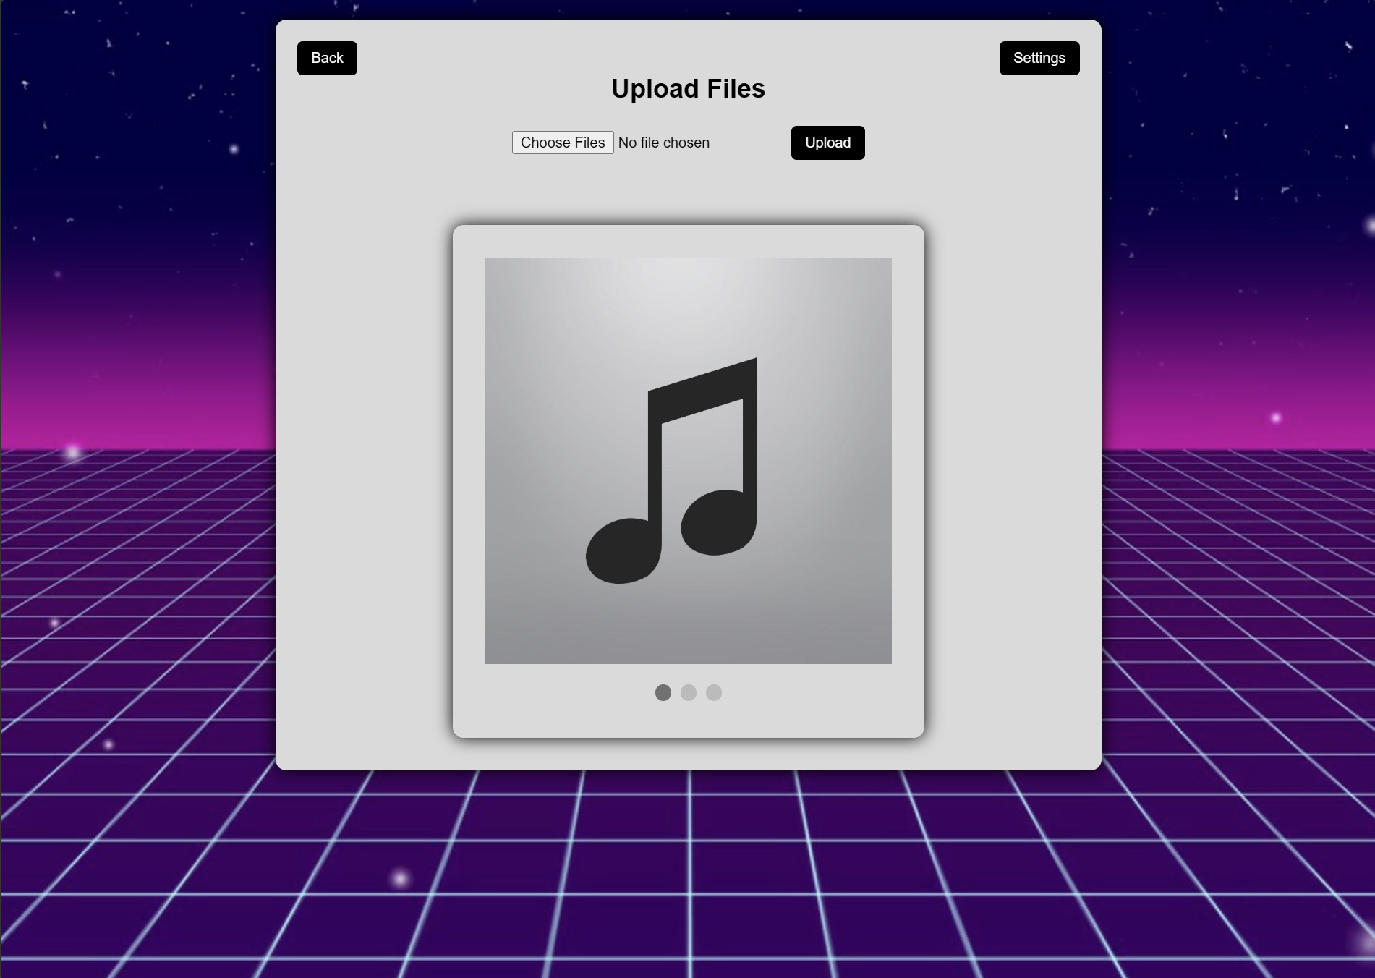
A new theme for the game board
New Theme
Added a progress bar
Score, Combo, and Missed Note Status
Perfect, Good, Missed Texts
Better indication of user input
A prototype for the level select screen

Slide 6
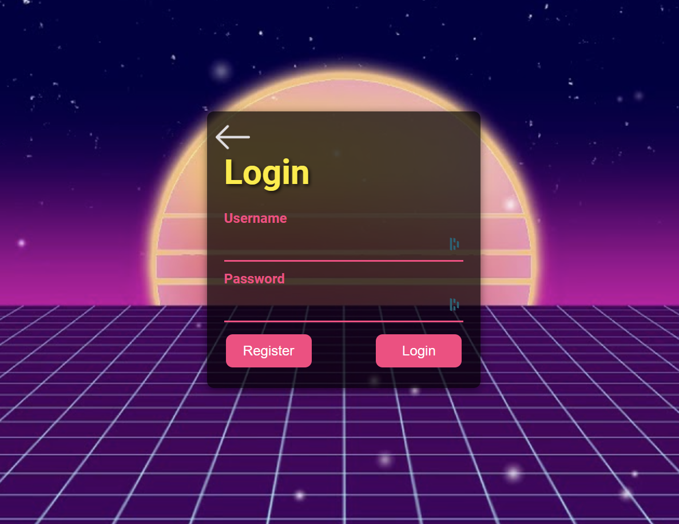
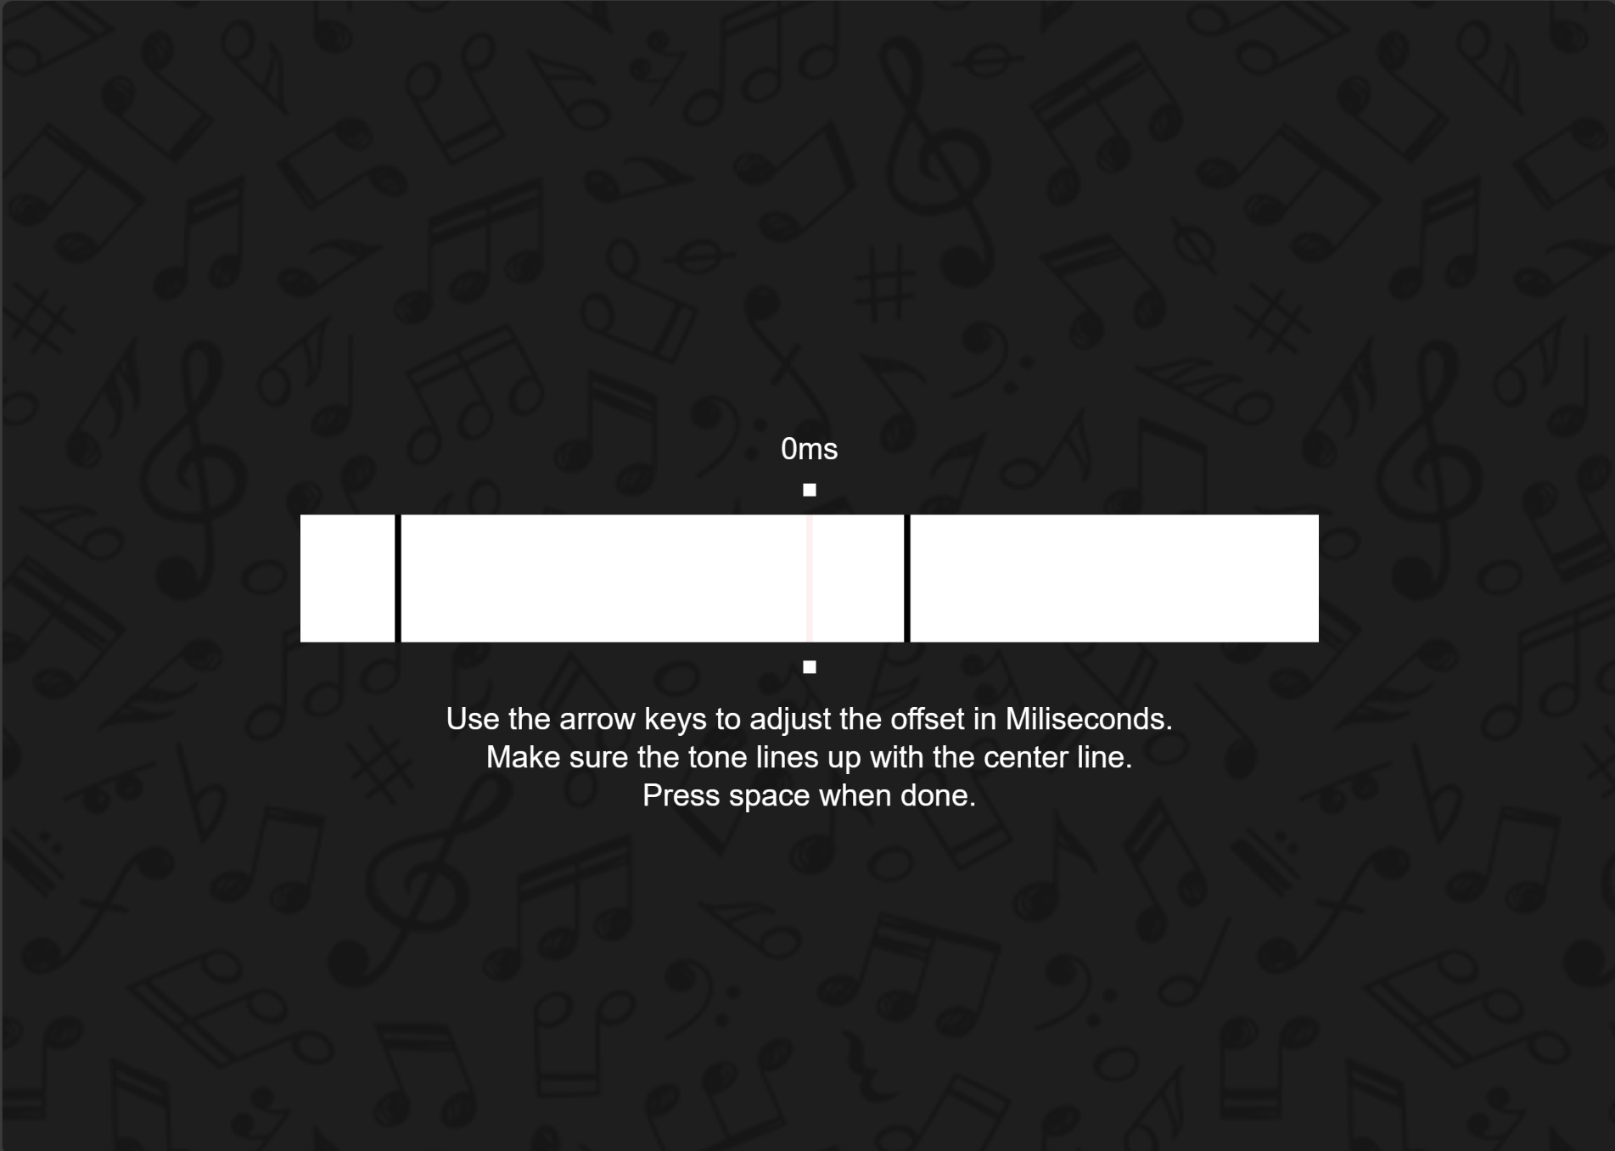
A login model to show the development of the user and score database.
A simple way to adjust audio latency

Slide 7
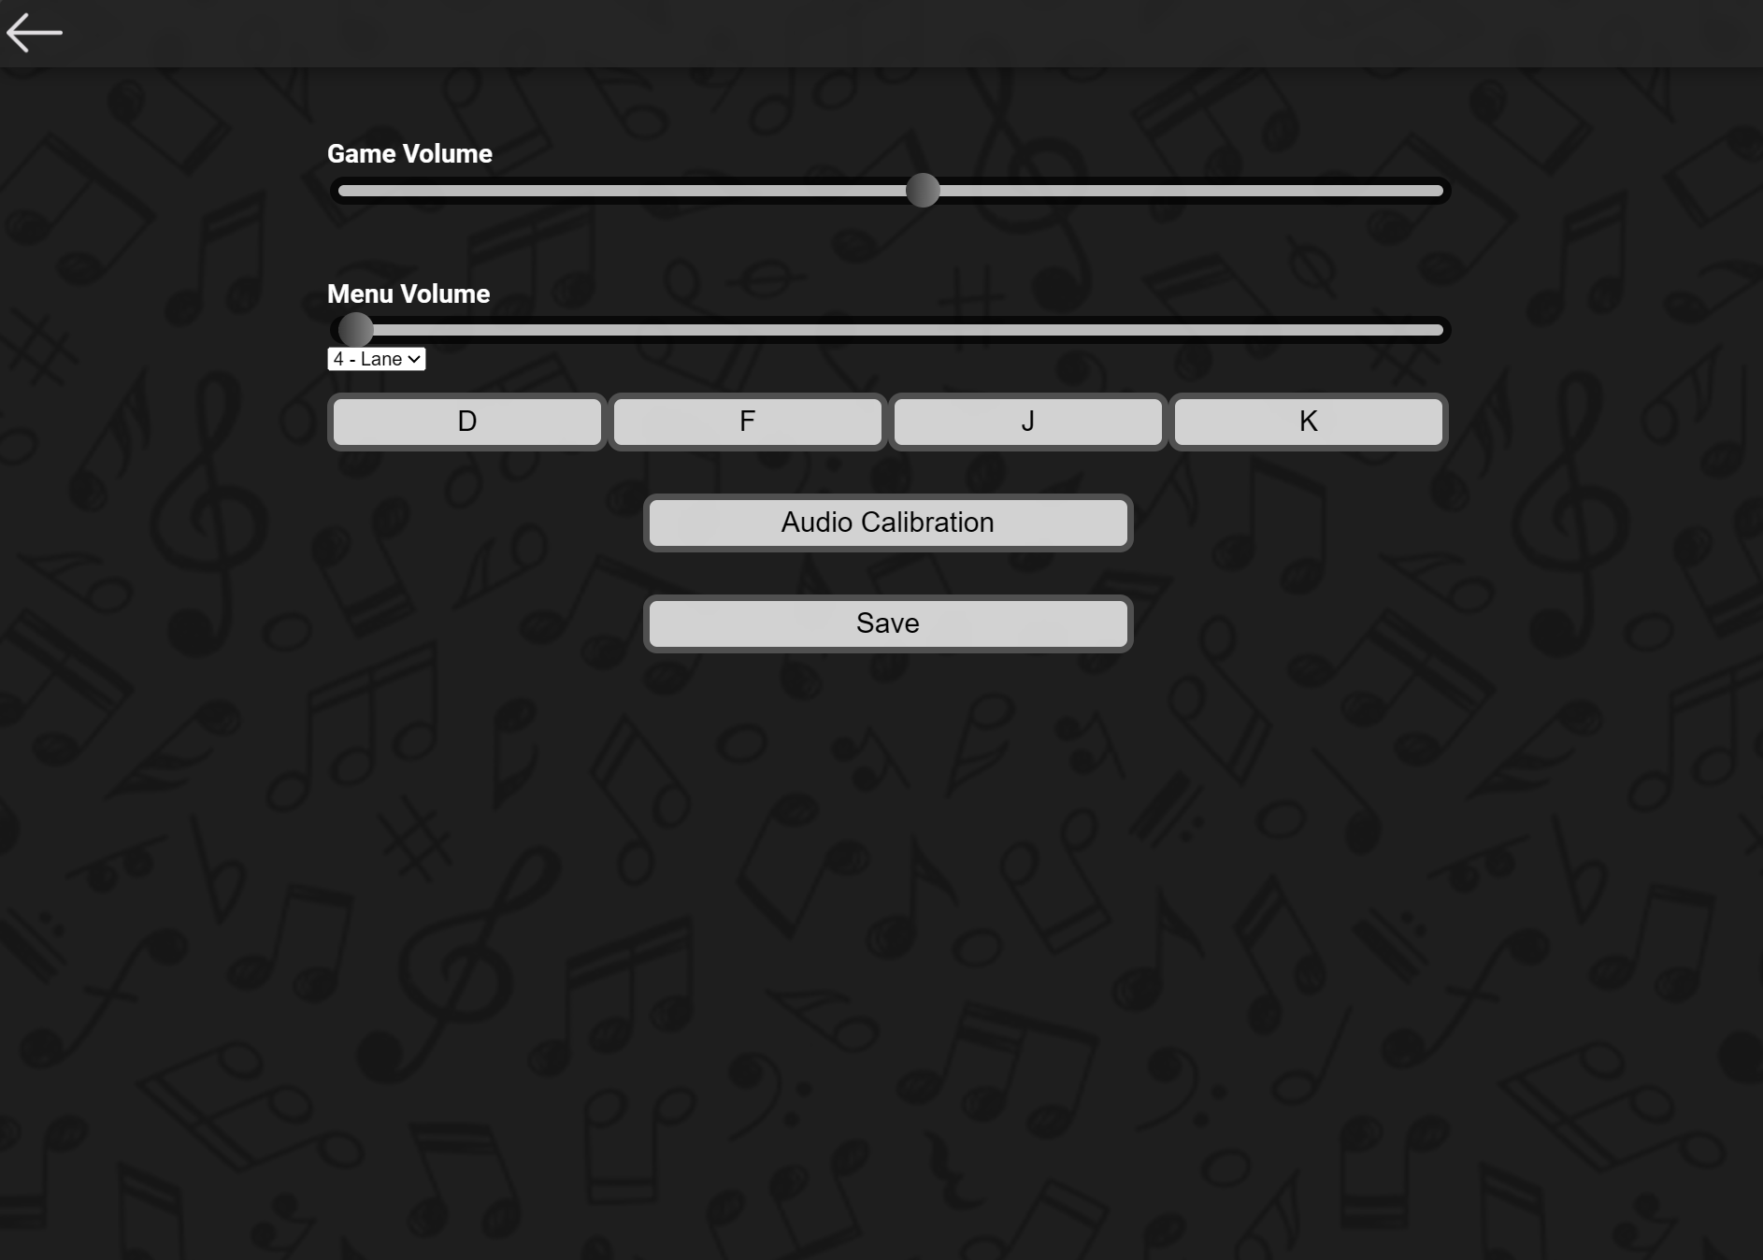
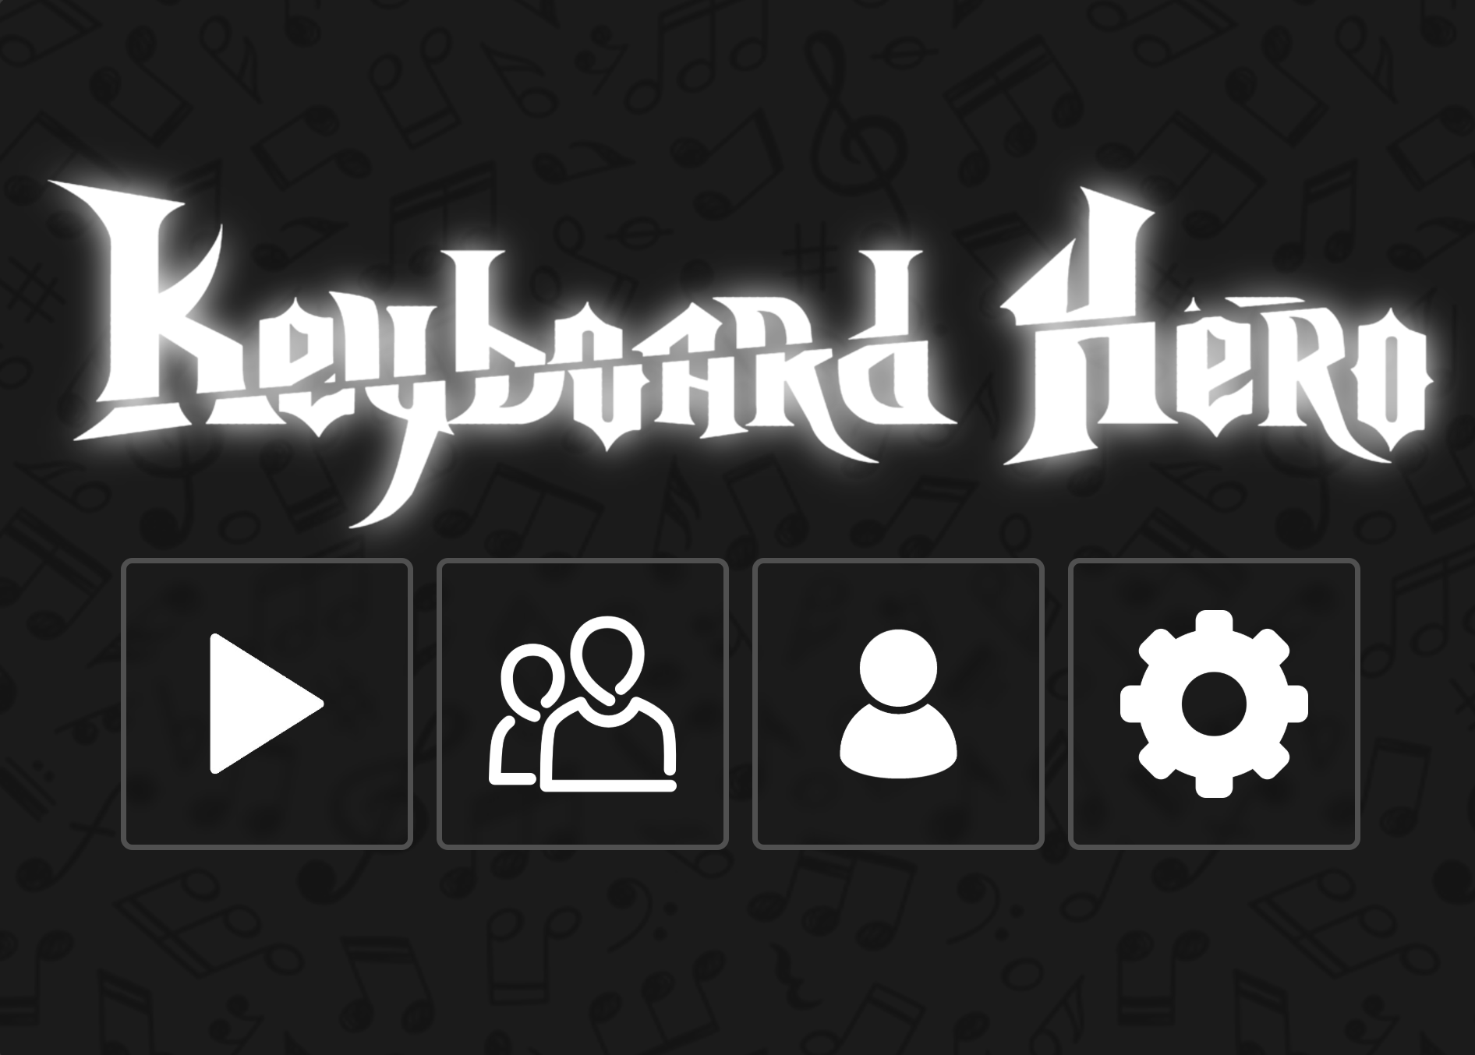
Theme Coherence
All menus where updated to follow the new, modern theme

Slide 8
Current Product Demo
What we Produced

Slide 9
Creation of the Product
What we Used and How

Slide 10
Software and Tools Used
Frontend
HTML
Website Design
Javascript
Website Interactivity
Backend
p5.js
Rendering Framework
jQuery
Async HTML Injecting
Python
Beatmap Generation Algorithm
Librosa
Python library for music and audio analysis
JSON
Various Data Interchanges
Database
MariaDB
Holds User and Scoreboard Data

Slide 11
Weekly Process
Weekly Stand-Up Meetings - Held every Friday
Established issues for the week and their priorities.
Communicated problems, progress, and needs (YTIs).
Discussed feedback from stakeholder.
Issue List / Backlog
Group members tackled issues throughout each Sprint.
Issues status was updated on a Kanban board.
All issues were reviewed by other team members.
Production and Development Branches
Production: Working copy that was updated weekly at the end of each Sprint.
Development: Updated regularly throughout the week as issues were completed.

Slide 12
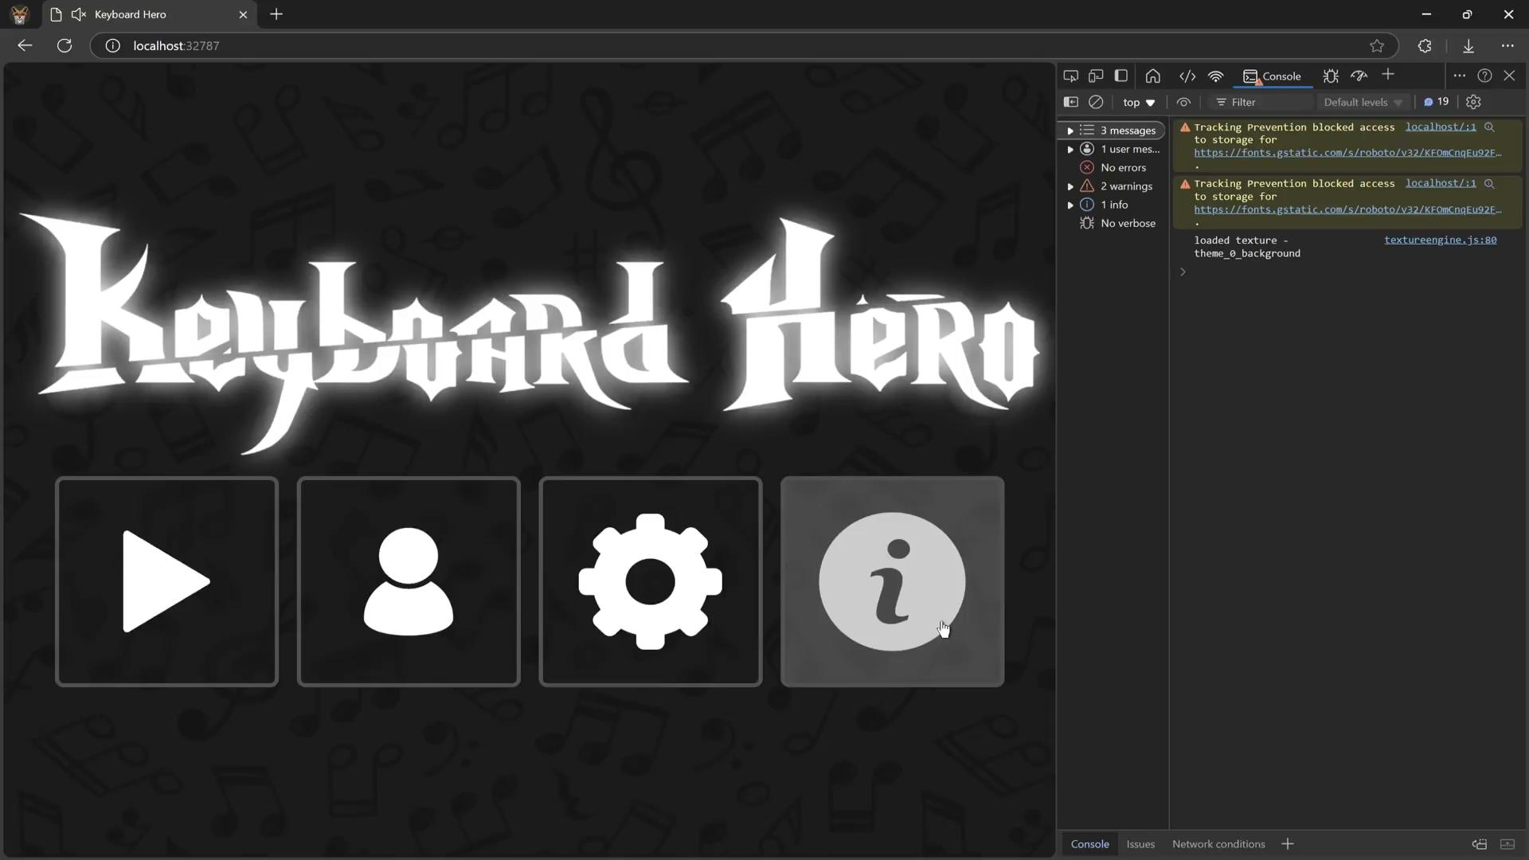
Testing/TDD
A set of tests were maintained within a single Javascript file and run each Sprint.
Tests were added for each new feature.
Tests are automated and are runnable through the browser.
Testing Process Video

Slide 13

From Our Stakeholder

Slide 14
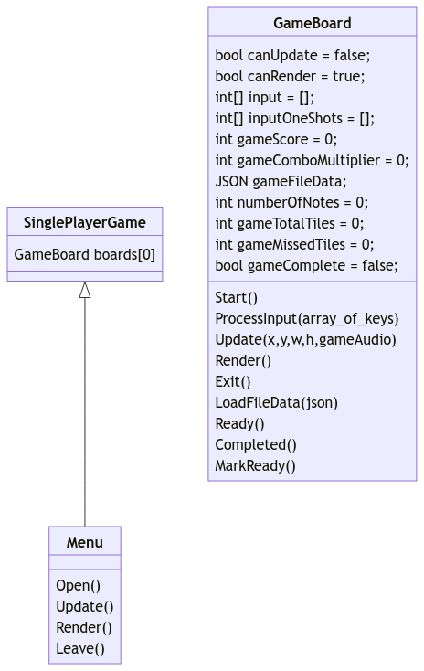
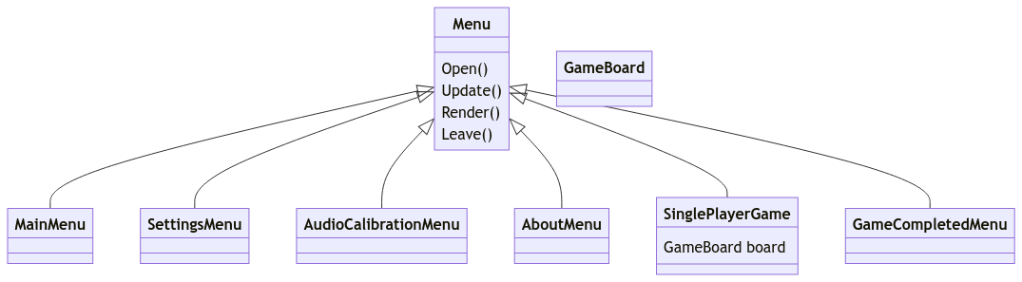
UML Diagram - Main Application

Slide 15
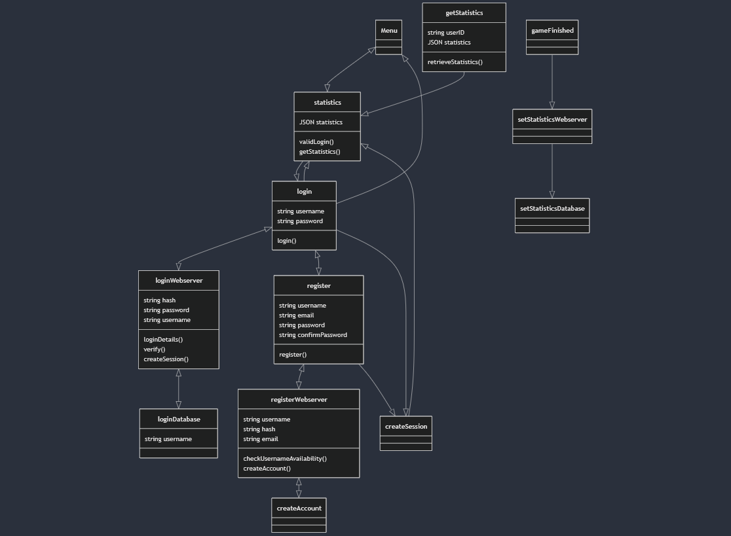
UML Diagram - Login

Slide 16
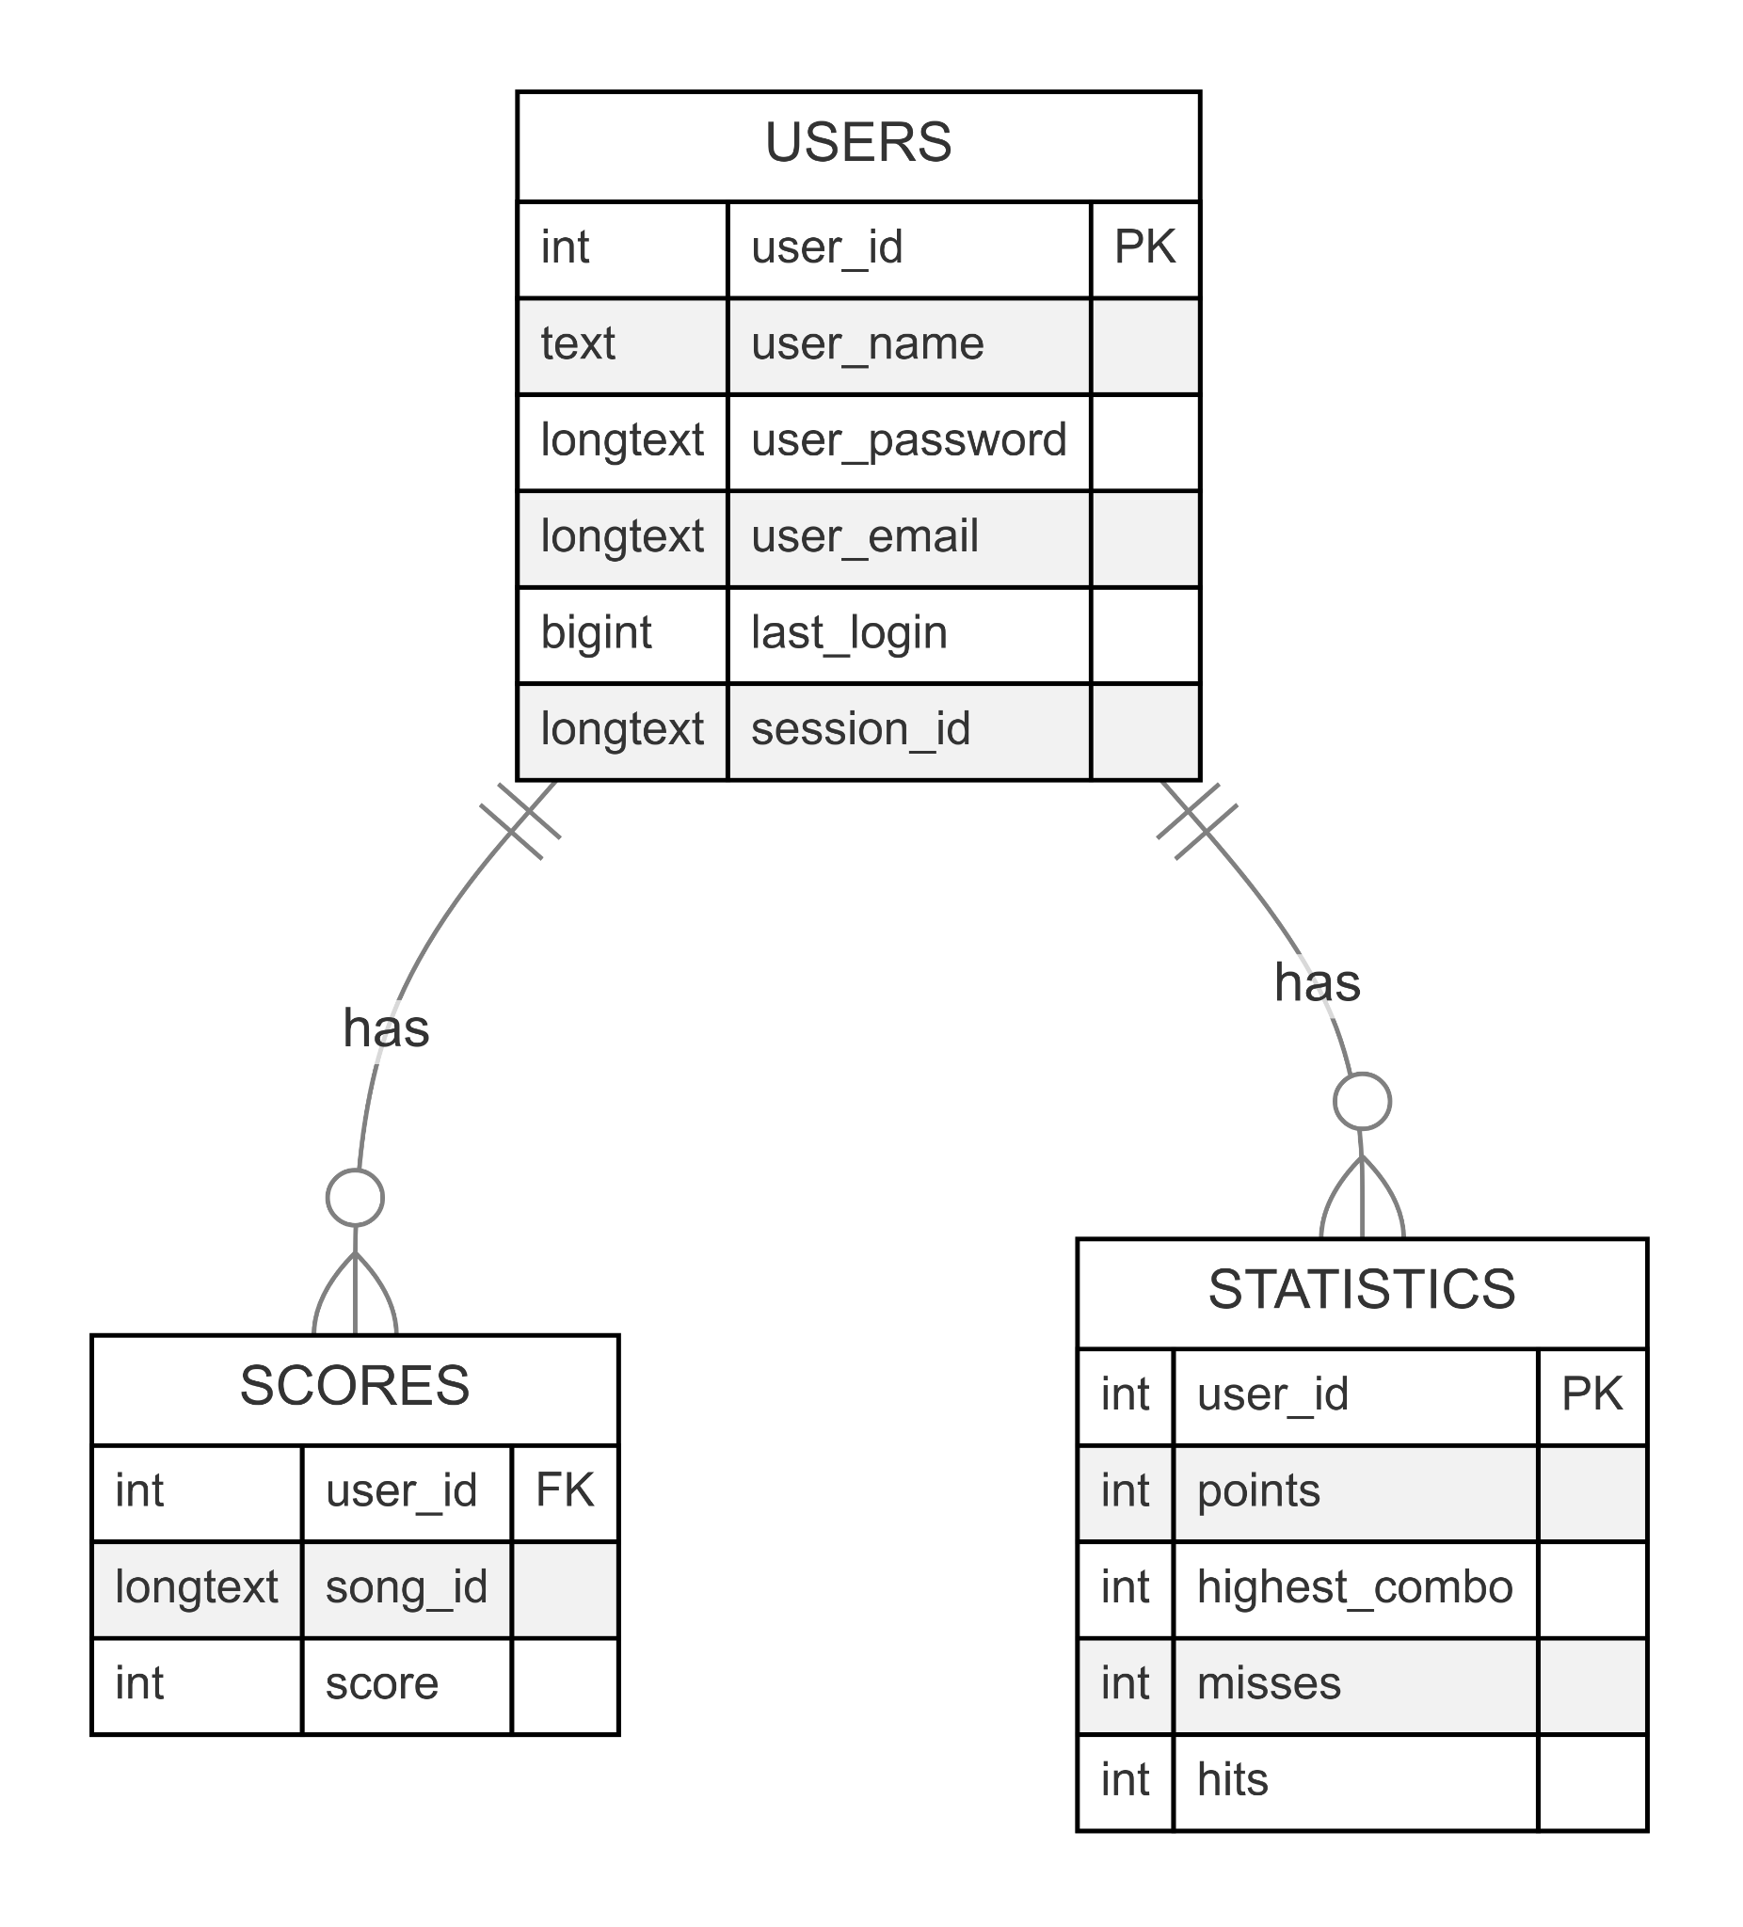
UML Diagram - Database Structure

Slide 17
Group Participation
How we all Contributed

Slide 18
Thank you!

